Slide 1

ML Project on House Price Prediction
By ASHOK KUMAR GUAL
MOB: +91-9901439279
Email: gualashok@gmail.com

Slide 2
Objectives of this project
Prediction of house price based on various features/facilities
House price is the target variable and all the features which influence it is the independent variables
Train the dataset using various ML model & choose the best suited model so that we can achieve the more accuracy on house price prediction

Slide 3
Steps followed for this project
Get the data set and load it
Do EDA on data set.
Find out the correlation of all the features with respect to house price
Choose the no of features to process it on ML model
Find out the models accuracy.
Select the ML model which gives the most reliable accuracy

Slide 4
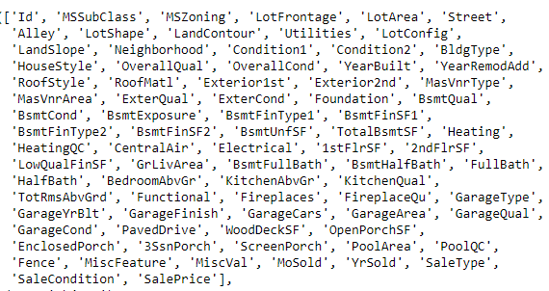
EDA on DataSet
Shape of data: (1460,81)

Slide 5
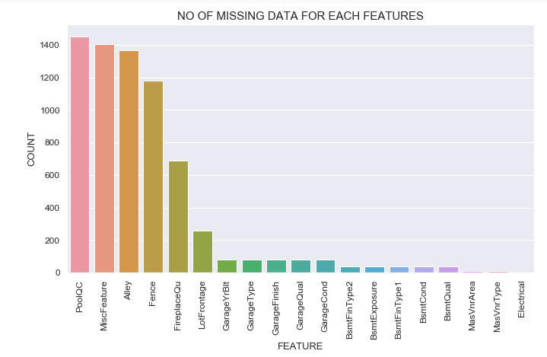
Missing values and its count

Slide 6
Cleaning of data
Dropping irrelevant columns
Handling of missing data i’e replacing it with mean, mode & np.NaN values
Make sure missing data handled properly

Slide 7
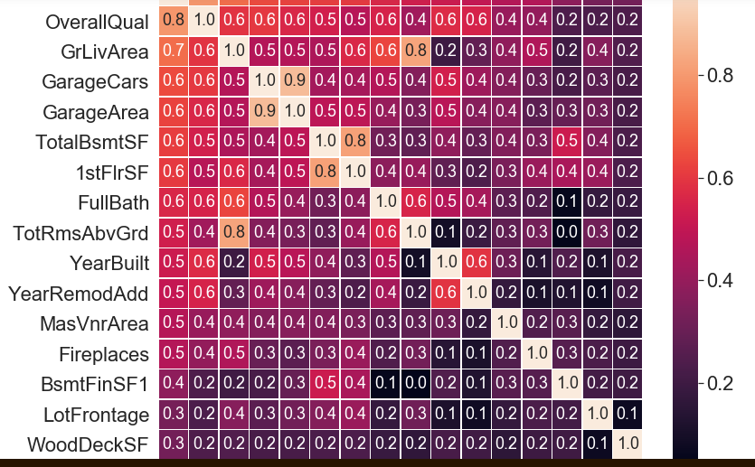
Select the sale price highly influencing variable

Slide 8
Based on our target variable choose ML model & apply it
Linaer Regression Model
Random Forest Regressor Model

Slide 9
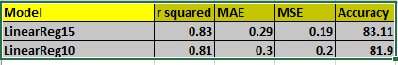
Linear regression model using 15 & 10 features

Slide 10
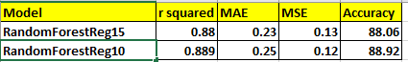
Random Forest Regressor model on 15 & 10 features

Slide 11
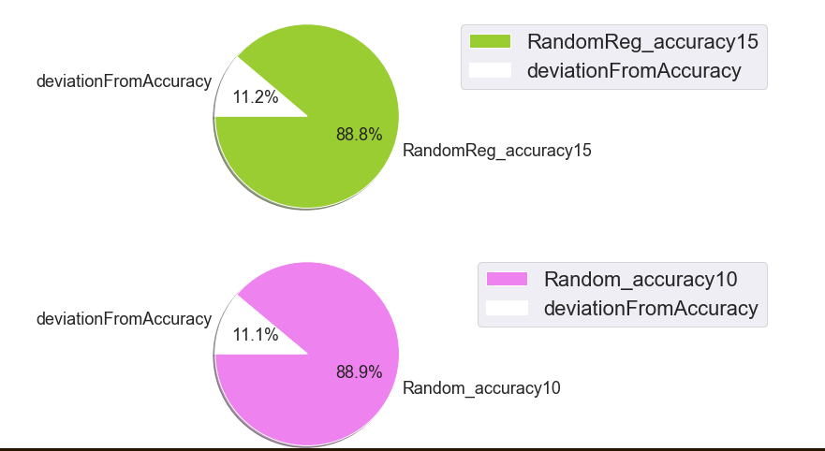
Random Forest Regressor model is the best suited model for house price prediction

Slide 12

Conclusion
If we compare Linear Regression model and random forest regressor model using 15 & 10 independent variables, Random forest model has higher accuracy and consistency. Hence we should choose random forest regressor model for house price prediction

Slide 13
Thank You

